Slide 1

Develop A Coworking Registry Project 4Work
Arianne Guedes
Jorge Gayer

Slide 2
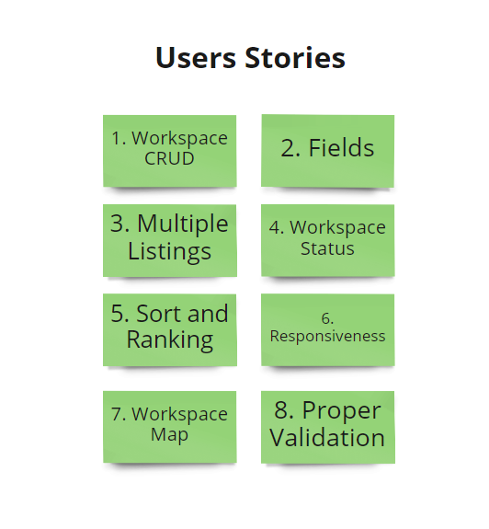
Notes:
1. As an owner I want to create, inspect, update, and delete a listing for my space
2. As an owner I want to have the following details attached to my listing: Name of the building, neighborhood, location, etc.
3. As an owner I want to be able to have multiple listings since I'll likely have more than one space to rent
4. As an owner I want to be able to mark a listing "rented" or "not rented“
5. As a user or an owner I want to filter and rank listings using these criteria: price, availability, amenities, etc.
6. As a user or owner I want to use this service on my phone or on my desktop
7. As a user or owner I want to see the location of a listing on a map
8. As an owner I want to ensure I cannot enter missing or invalid information on my listing

Slide 3
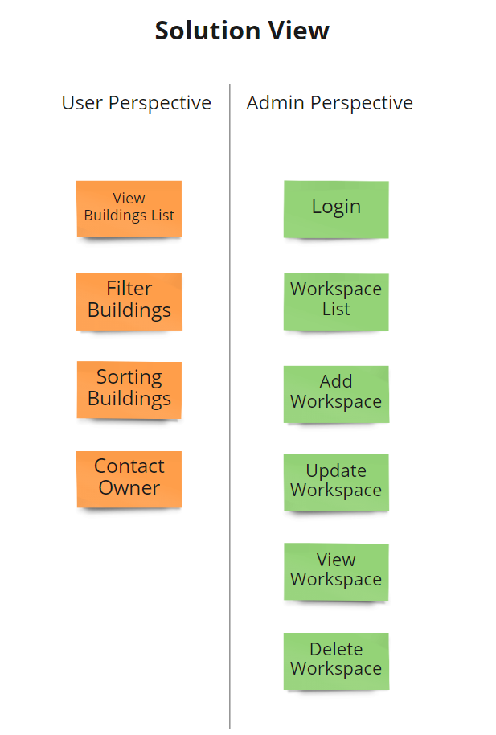

Slide 4
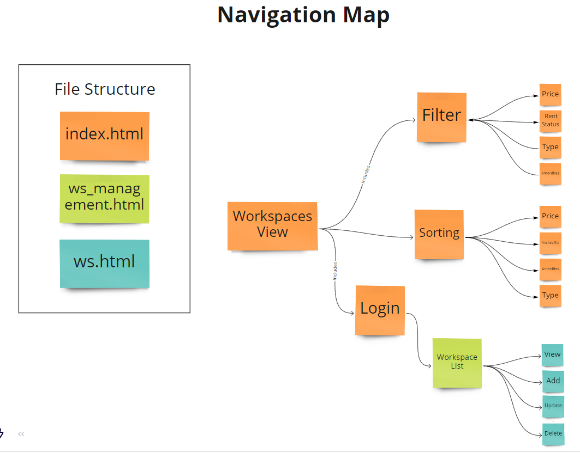

Slide 5
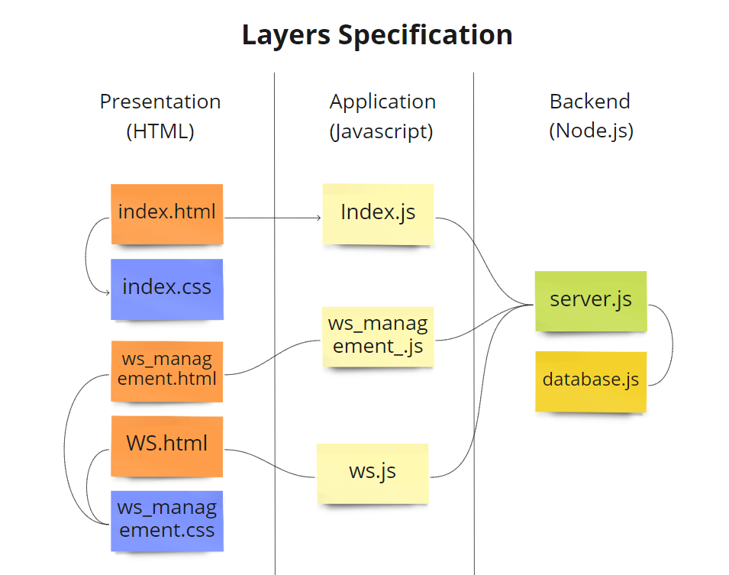

Slide 6
